Slide 3
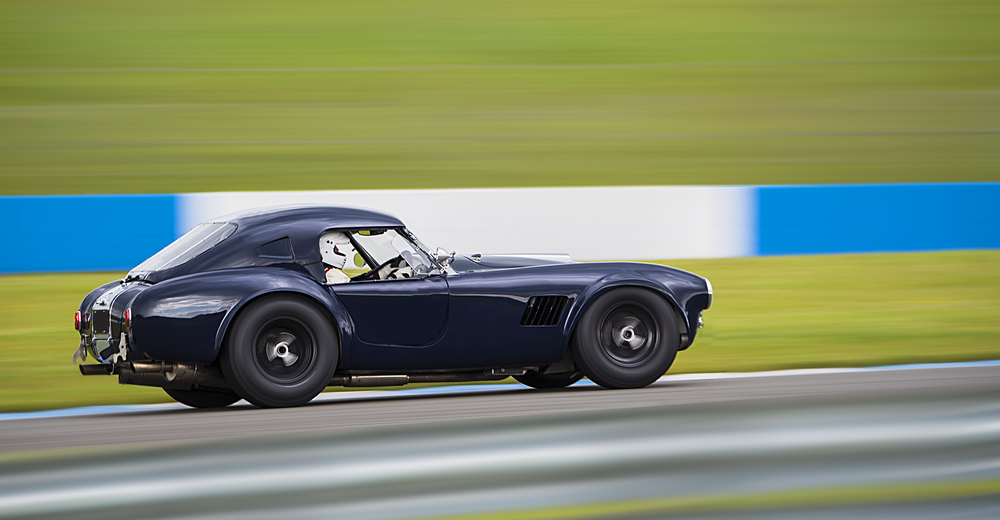

Slide 4
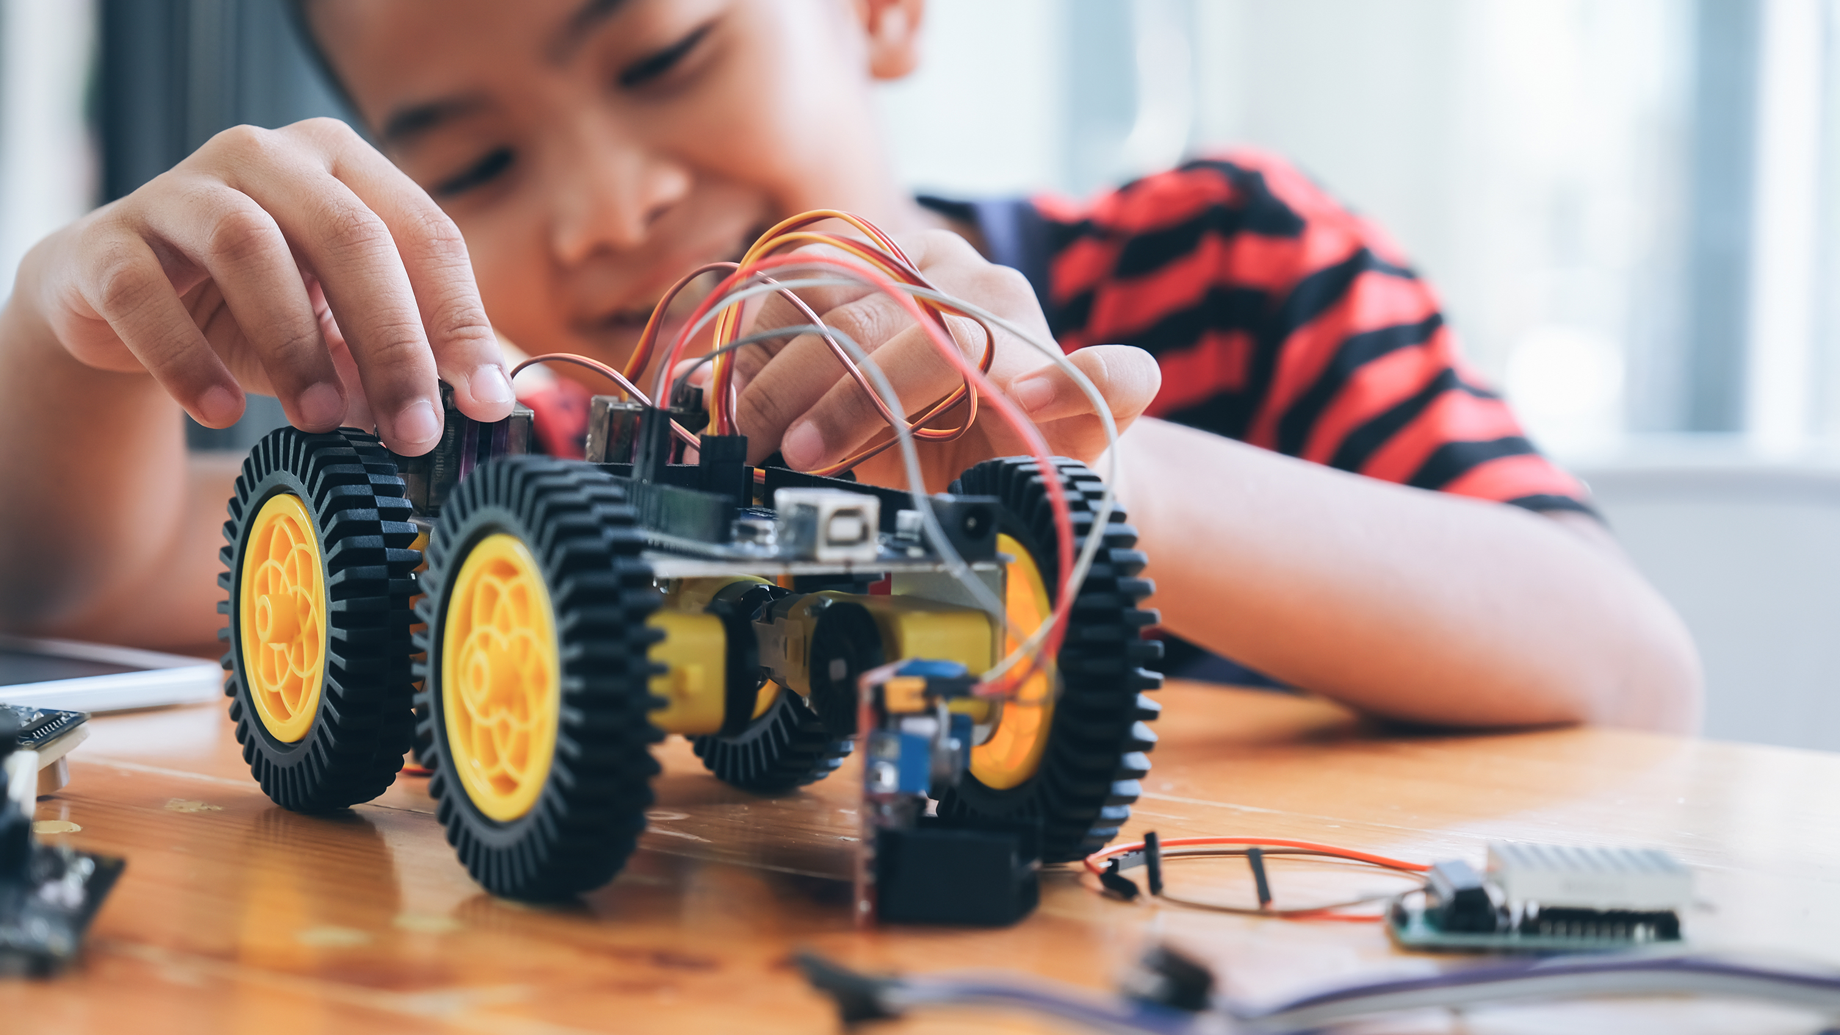

Slide 5

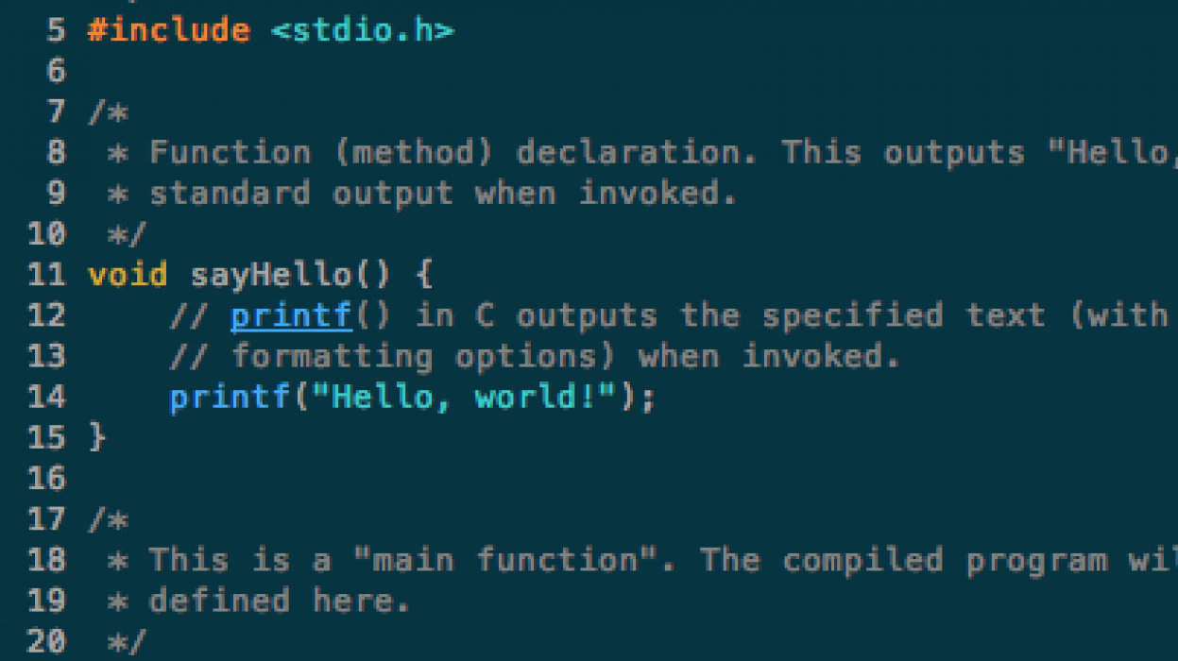
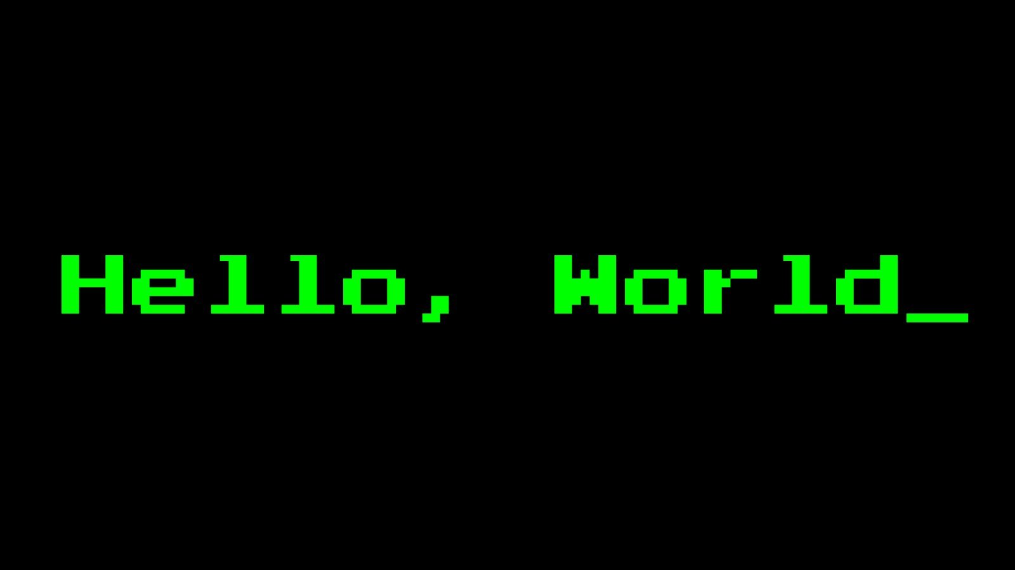
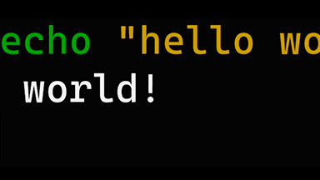
This Photo by Unknown Author is licensed under CC BY-SA-NC
This Photo by Unknown Author is licensed under CC BY-SA
This Photo by Unknown Author is licensed under CC BY-NC
Notes:
저는 다양한 언어로 ‘Hello World’를 찍어본 경험이 있습니다.
Java, javascript, ruby, python, php 등등…
엄청난 개발자는 되지 못했습니다.

